Slide 1

Frontiers of Network Science
Fall 2023
Class 11: Evolving Networks II Degree Correlations
(Chapters 5 & 7 in Textbook)
based on slides by
Albert-László Barabási
and Roberta Sinatra
Boleslaw Szymanski
www.BarabasiLab.com

Slide 2
Evolving network models
Network Science: Evolving Network Models

Slide 3
EVOLVING NETWORK MODELS
The BA model is only a minimal model.
Makes the simplest assumptions:
linear growth
linear preferential attachment
Does not capture
variations in the shape of the degree distribution
variations in the degree exponent
the size-independent clustering coefficient
Hypothesis:
The BA model can be adapted to describe most features of real networks.
We need to incorporate mechanisms that are known to take place in real networks: addition of links without new nodes, link rewiring, link removal; node removal, constraints or optimization
Network Science: Evolving Network Models

Slide 4
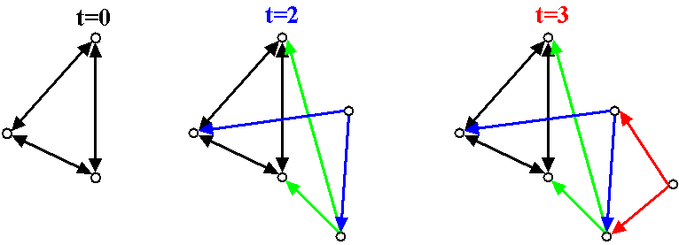
(the simplest way to change the degree exponent)
BA ALGORITHM WITH DIRECTED EDGES
Undirected BA network:
Directed BA network:
β=1: dynamical exponent
γ_{in}=2: degree exponent; P(k_{out})=δ(k_{out}-m)
Undirected BA: β=1/2; γ=3
Network Science: Evolving Network Models

Slide 5
EXTENDED MODEL: Other ways to change the exponent
Extended Model
prob. p : internal links
prob. q : link deletion
prob. 1-p-q : add node
P(k) ~ (k+κ(p,q,m))^{-γ(p,q,m)}
γ ∈ [1,∞)
Network Science: Evolving Network Models
Notes:
It also

Slide 6
EXTENDED MODEL: Small-k cutoff
P(k) ~ (k+κ(p,q,m))^{-γ(p,q,m)} γ ∈ [1,∞)
Extended Model
prob. p : internal links
prob. q : link deletion
prob. 1-p-q : add node
→Predicts a small-k cutoff
a correct model should predict all aspects of the degree distribution, not only the degree exponent.
Degree exponent is a continuous function of p,q, m
p=0.937
m=1
κ = 31.68
γ = 3.07
Actor network
Network Science: Evolving Network Models
Notes:
It also

Slide 7
NONLINEAR PREFERENTIAL ATTACHMENT: MORE MODELS
Non-linear preferential attachment:
→ P(k) does not follow a power law for α≠1
⇒ α<1 : stretch-exponential
⇒ α>1 : no-scaling (α>2 : “gelation”)
P. Krapivsky, S. Redner, F. Leyvraz, Phys. Rev. Lett. 85, 4629 (2000)
Network Science: Evolving Network Models

Slide 8
INITIAL ATTRACTIVENESS
BA model: k=0 nodes cannot aquire links, as Π(k=0)=0
(the probability that a new node will attach to it is zero)
A - initial attractiveness
Initial attractiveness shifts the degree exponent:
Note: the parameter A can be measured from real data, being the rate at which k=0 nodes acquire links, i.e. Π(k=0)=A
Dorogovtsev, Mendes, Samukhin, Phys. Rev. Lett. 85, 4633 (2000)
Network Science: Evolving Network Models

Slide 9
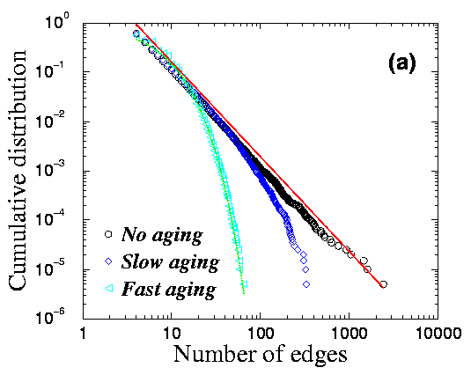
GROWTH CONSTRAINTS AND AGING CAUSE CUTOFFS
Finite lifetime to acquire new edges
L. A. N. Amaral et al., PNAS 97, 11149 (2000)
Gradual aging:
S. N. Dorogovtsev and J. F. F. Mendes, Phys. Rev. E 62, 1842 (2000)
Network Science: Evolving Network Models

Slide 10


THE LAST PROBLEM: HIGH, SYSTEM-SIZE INDEPENDENT C(N)
Pathlenght
Clustering
Degree Distr.
P(k) ~ k^{-γ}
Regular network
P(k)=δ(k-k_{d})
Erdos-
Renyi
Watts-
Strogatz
Exponential
Barabasi-Albert
P(k) ~ k^{-γ}
Network Science: Evolving Network Models
Notes:
As we can see, the BA model gets approximatelly right the small world effect, the degree distribution. When it comes to the clustering coefficient, the bad news is that it still decreases with the system size. The good news, is that it decreases slower that the ER prediction. Most important, however, the real difference is this: the model is really a modeling platform, that can be adjusted to the properties of real networks– we will see that in fact it can generate a finite, system size independnet clustering coefficient, if our main goal is to do just that.

Slide 11
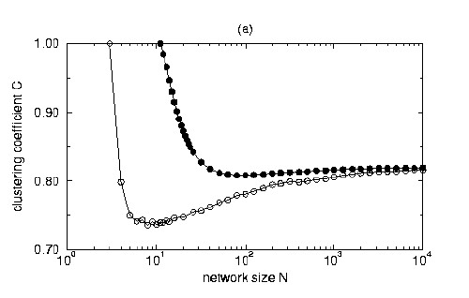
A MODEL WITH HIGH CLUSTERING COEFFICIENT
Each node of the network can be either active or inactive.
There are m active nodes in the network in any moment.
Start with m active, completely connected nodes.
Each timestep add a new node (active) that connects to m active nodes.
Deactivate one active node with probability:
C→ C* when N→∞
K. Klemm and V. Eguiluz, Phys. Rev. E 65, 036123 (2002)
Network Science: Evolving Network Models

Slide 12
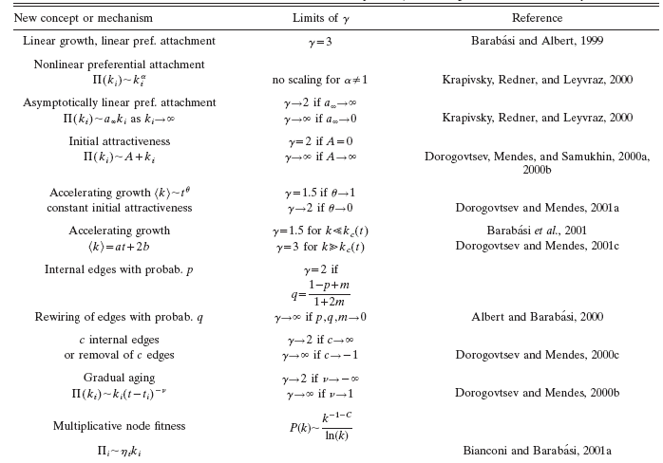
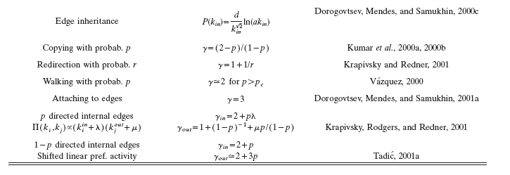

Slide 13
Section 11: Summary
The network grows, but the degree distribution is stationary.

Slide 14
Section 11: Summary
The network grows, but the degree distribution is stationary.

Slide 15
Section 11: Summary

Slide 16
LESSONS LEARNED: evolving network models
There is no universal exponent characterizing all networks.
Growth and preferential attachment are responsible for the emergence of the scale-free property.
The origins of the preferential attachment is system-dependent.
Modeling real networks:
      identify the microscopic processes that take place in the system
      measure their frequency from real data
      develop dynamical models that capture these
      processes.
5. If the model is correct, it should correctly predict not only the degree exponent, but both small and large k-cutoffs.
Network Science: Evolving Network Models

Slide 17
LESSONS LEARNED: evolving network models
Philosophical change in network modeling:
ER, WS models are static models – the role of the network modeler it to cleverly place the links between a fixed number of nodes to that the network topology mimic the networks seen in real systems.
BA and evolving network models are dynamical models: they aim to reproduce how the network was built and evolved.
Thus their goal is to capture the network dynamics, not the structure.
→ as a byproduct, you get the topology correctly
Network Science: Evolving Network Models

Slide 18
LESSONS LEARNED: evolving network models
Philosophical change in network modeling:
ER, WS models are static models – the role of the network modeler it to cleverly place the links between a fixed number of nodes to that the network topology mimic the networks seen in real systems.
BA and evolving network models are dynamical models: they aim to reproduce how the network was built and evolved.
Thus their goal is to capture the network dynamics, not the structure.
→ as a byproduct, you get the topology correctly
Network Science: Evolving Network Models

Slide 19
DEGREE CORRELATIONS IN NETWORKS
Assortative:
hubs show a tendency to link to each other.
Neutral:
nodes connect to each other with the expected random probabilities.
Disassortative:
Hubs tend to avoid linking to each other.
Quantifying degree correlations (three approaches):
→ full statistical description (Maslov and Sneppen, Science 2001)
→ degree correlation function (Pastor Satorras and Vespignani, PRL 2001)
→ correlation coefficient (Newman, PRL 2002)
Network Science: Degree Correlations

Slide 20
STATISTICAL DESCRIPTION
e_{jk}: probability to find a node with degree j and degree k at the two ends of a randomly selected edge
q_{k}: the probability to have a degree k node at the end of a link.
Where:
Probability to find a node at the end of a link is biased towards the more connected nodes, i.e. q_{k}=Ckp_{k,} where C is a normalization constant . After normalization we find C=1/<k>, or q_{k}=kp_{k}/<k>
If the network has no degree correlations:
Deviations from this prediction are a signature of degree correlation.
M. E. J. Newman, Phys. Rev. Lett. 89, 208701 (2002)
Network Science: Degree Correlations

Slide 21
EXAMPLE: e_{jk} FOR A SCALE-FREE NETWORK
Assortative:
More strength in the diagonal, hubs tend to link to each other.
Neutral
Disassortative:
Hubs tend to connect to small nodes.
Each matrix is the average of a 100 independent scale-free networks, generated using the static model with N=10⁴, γ=2.5 and <k>=3.
Network Science: Degree Correlations

Slide 22
EXAMPLE: e_{jk} FOR A SCALE-FREE NETWORK
Assortative:
More strength in the diagonal, hubs tend to link to each other.
Perfectly assortative network:
e_{jk}=q_{k}δ_{jk}
Disassortative:
Hubs tend to connect to small nodes.
Perfectly disassortative network:
Each matrix is the average of a 100 independent scale-free networks, generated using the static model with N=10⁴, γ=2.5 and <k>=3.
Network Science: Degree Correlations

Slide 23
REAL-WORLD EXAMPLES
Astrophysics co-authorship network
Yeast PPI
Assortative:
More strength in the diagonal, hubs tend to link to each other.
Disassortative:
Hubs tend to connect to small nodes.
Network Science: Degree Correlations

Slide 24
PROBLEM WITH THE FULL STATISTICAL DESCRIPTION
(1) Difficult to extract information from a visual inspection of a matrix.
(2) Based on e_{jk} and hence requires a large number of elements to inspect:
Nr. of independent elements
Undirected network:
k_{max} x k_{max} matrix
Constraints
We need to find a way to reduce the information contained in e_{jk}
M. E. J. Newman, Phys. Rev. Lett. 89, 208701 (2002)
Network Science: Degree Correlations

Slide 25
Average next neighbor degree
k_{annd} (k): average degree of the first neighbors of nodes with degree k.
No degree correlations:
If there are no degree correlations, k_{annd}(k) is independent of k.
R. Pastor-Satorras, A. Vázquez, A. Vespignani, Phys. Rev. E 65, 066130 (2001)
Network Science: Degree Correlations

Slide 26
k_{annd}(k) FOR REAL NETWORKS
Astrophysics co-authorship network
Yeast PPI
Assortative
Disassortative
Network Science: Degree Correlations
Notes:
In reality we see significant deviations from the neutral behavior.

Slide 27
Average next neighbor degree
k_{annd}(k): average degree of the first neighbors of nodes with degree k.
k_{max}-1 independent
elements
constraint:
k_{annd}(k) is a k-dependent function, hence it has much fewer parameters,
and it is easier to interpret/read.
R. Pastor-Satorras, A. Vázquez, A. Vespignani, Phys. Rev. E 65, 066130 (2001)
Network Science: Degree Correlations

Slide 28
PEARSON CORRELATION
If there are degree correlations, e_{jk} will differ from q_{j}q_{k}. The magnitude of the correlation is captured by <jk>-<j><k> difference, which is:
<jk>-<j><k> is expected to be:
positive for assortative networks,
zero for neutral networks,
negative for dissasortative networks
To compare different networks, we should normalize it with its maximum value; the maximum is reached for a perfectly assortative network, i.e. e_{jk}=q_{k}δ_{jk}
normalization:
disassortative
neutral
assortative
M. E. J. Newman, Phys. Rev. Lett. 89, 208701 (2002)
Network Science: Degree Correlations

Slide 29
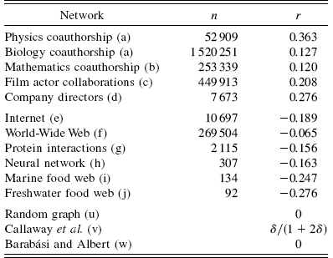
REAL NETWORKS
Social networks are assortative
Biological, technological networks are disassortative
r>0: assortative network:
Hubs tend to connect to other hubs.
r<0: disassortative network:
Hubs tend to connect to small nodes.
Network Science: Degree Correlations

Slide 30
RELATIONSHIP BETWEEN r AND k_{annd}
In general case we need to know q_{k} and k_{annd}(k) to calculate r.
Assuming:
Using the constraint for ANND:
Network Science: Degree Correlations

Slide 31
PROBLEM WITH THE PREVIOUS DEVIATION: k_{annd}(k)~k^{β}
Astrophysics co-authorship network
Yeast PPI
Assortative
Disassortative
Network Science: Degree Correlations

Slide 32
CONNECTION WITH ANND
Assuming:
Using the constraint for ANND:
Network Science: Degree Correlations

Slide 33
CONNECTION BETWEEN R AND k_{ANND}
Network Science: Degree Correlations

Slide 34
DEGREE CORRELATION IN NETWORKS
0.31
-0.16
Network Science: Degree Correlations

Slide 35
GENERATING NETWORK WITH GIVEN ASSORTATIVITY
We have a desired e_{jk} distribution, which also specifies p_{k}.
Generate a network with the desired degree distribution using the configuration model.
Choose two links at random from the network: (v₁,w₁) and (v₂,w₂).
Measure the degrees j₁, k₁, j₂, k₂ of nodes v₁, w₁, v₂, w₂. Replace the two selected links with two new ones (v₁,v₂) and (w₁,w₂) with probability
Repeat from step 2.
The algorithm is ergodic and satisfies detailed balance, therefore in the long time limit it samples the desired network ensemble correctly.
M. E. J. Newman, Phys. Rev. E 67, 026126 (2003)
Network Science: Degree Correlations

Slide 36
GENERATING NETWORK WITH GIVEN ASSORTATIVITY
Choose two edges random from the network: (v₁,w₁) and (v₂,w₂).
Measure the degrees j₁, k₁, j₂, k₂ of vertices v₁, w₁, v₂, w₂. Replace the two selected edges with two new ones (v₁,v₂) and (w₁,w₂) with probability
1
2
3
4
Network Science: Degree Correlations

Slide 37
GENERATING NETWORK WITH GIVEN ASSORTATIVITY
If we only specify r we have great degree of freedom in choosing e_{jk.}
Possible choice for disassortative case:
Where x_{k} is any normalized distribution.
This form satisfies the constraints on e_{jk}:
The r value can be easily calculated:
Assortative case:
M. E. J. Newman, Phys. Rev. E 67, 026126 (2003)
Network Science: Degree Correlations

Slide 38
EXAMPLE: Erdős-Rényi
e
Network Science: Degree Correlations

Slide 39
EXAMPLE: Erdős-Rényi
Network Science: Degree Correlations

Slide 40
Structural cut-off
High assortativity→ high number of links between the hubs.
If we allow only one link between two nodes, we can simply run out of hubs to connect to each other to satisfy the assortativity criteria.
Number of edges between the set of
nodes with degree k and degree k’:
This represents the number of edges
Maximum number of edges between
the two groups:
This is frequency of edges with degree kk’
If we only have simple edges, we cannot have more links between the two groups, than if we connect every node with degree k to every node with degree k’ once.
There cannot be more links between the two groups, than the overall number of edges joining the nodes with degree k, or k’
This is true even if we allow multiple edges.
M. Boguñá, R. Pastor-Satorras, A. Vespignani, EPJ B 38, 205 (2004)

Slide 41
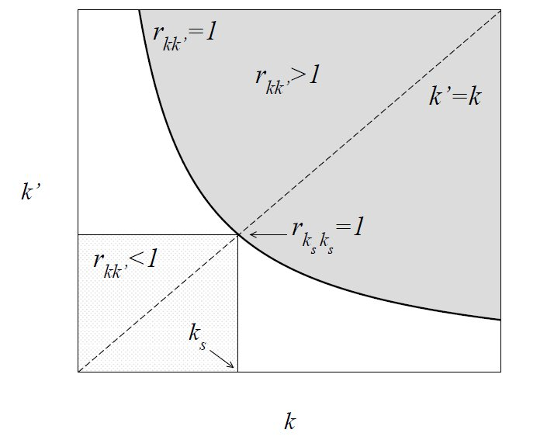
Structural cut-off
The ratio of E_{kk’} and m_{kk’} has to be ≤ 1 in the physical region!
defines the structural cut-off
M. Boguñá, R. Pastor-Satorras, A. Vespignani, EPJ B 38, 205 (2004)

Slide 42
Structural cut-off for uncorrelated networks
Uncorrelated networks:
k_{s}(N) represents a structural cutoff:
one cannot have nodes with degree larger than k_{s}(N) ,
→if there are nodes with k> k_{s}(N) we cannot find sufficient links between the highly connected nodes to maintain the neutral nature of the network.
Solution:
Introduce a structural cutoff (i.e. do not allow nodes with k> k_{s}(N)
Let the network become more dissasortative, having fewer links between hubs.

Slide 43
Example: Degree sequence introduces disassortativity
Scale-free network generated with the configuration model (N=300, L=450, γ=2.2).
The measured r=-0.19! → Dissasortative!
Red hub: 55 neighbors.
Blue hub: 46 neighbors.
Let’s calculate the expectation number of links between red node (k=55) and blue node (k=46) for uncorrelated networks!
Here N₅₅=N₄₆=1, hence
m_{55,46}=1 so r_{55,46}=E_{55,46}
In order for the network to be neutral, we need 2.8 links between these two hubs.

Slide 44
<k_{nn}>
The largest nodes have k_{nn}< <k_{nn}>

Slide 45
The effect is particularly clear for N=10,000:
<k_{nn}>
The red curves are those of interest to us: one can see that a clear dissasortativity property is visible in this case.

Slide 46
Natural cutoffs in scale-free networks
All real networks are finite → let us explore its consequences.
→ We have an expected maximum degree, K_{max}
Estimating K_{max}
Why: the probability to have a node larger than K_{max} should not exceed the prob. to have one node, i.e. 1/N fraction of all nodes
Natural cutoff:

Slide 47
Structural cut-off for uncorrelated networks
Structural cutoff:
Natural cut-off:
γ=3: k_{s}(N) and k_{max}(N) scale the same way, i.e. ~N^{1/2}.
The size of the largest hub is above the structural cutoff, which means that it cannot have enough links to the other hubs to maintain its neutral status.
→ disassortative mixing
γ<3:
→a randomly wired network with γ<3 will be
dissasortative
Or will have to have a cutoff at k_{s}(N)< k_{max}(N)
Notes:
We are interested only in SF networks, as ER network do not have hubs, and thus the problem is less acute.

Slide 48
Example: introducing a structural cut-off
Scale-free network generated with the configuration model (N=300, L=450, γ=2.2) with structural cut-off ~ N^{½}.
r=0.005 → neutral
Red hub: 12 neighbors.
Blue hubs: 11 neighbors.
Again we can calculate the expectation number of edges between the hubs.

Slide 49
<k_{nn}>
The largest nodes have k_{nn}~ <k_{nn}>

Slide 50
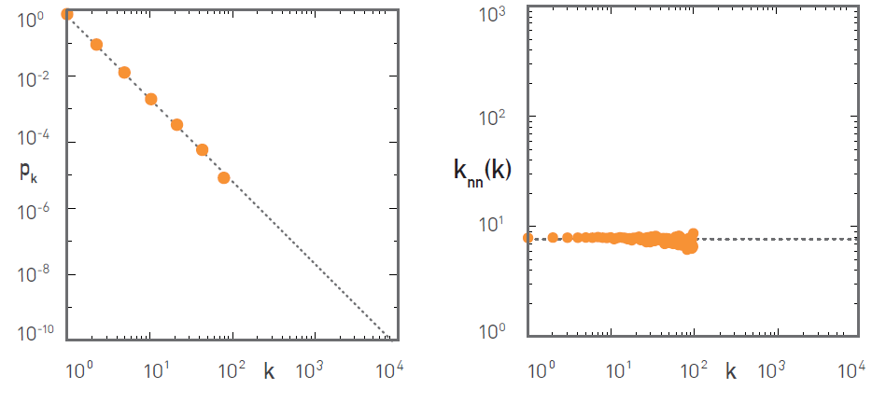
The effect is particularly clear for N=10,000:
A clear case of neutral assortativity property is visible in this case thanks to imposing structural cut-off.

